Slide 1


Humic Acid
Investigate humic acid performance in floc/sed model
More at Github-Humic Acid
Humic Acid | Research | Symposium Presentation Fall 2019
Notes:
[[Insert your abstract here.]]
[[Add a link to your full report here. ]]

Slide 2
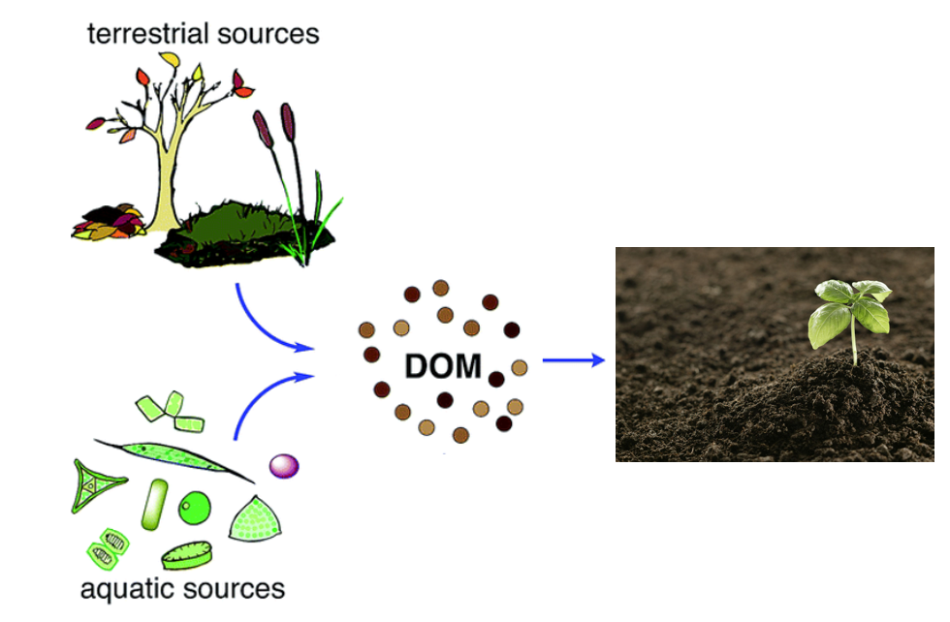
Background
Natural Organic Matter: Present in surface and groundwater
Humic Acid
1) Colour, taste and odor problems
2) Increased coagulant and disinfectant doses needed for removal
3) Biological growth in distribution system
4) Increased levels of complexed heavy metals and adsorbed organic pollutants
Reacts with chlorine during chlorination - harmful effects
Humic Acid | Research | Symposiums Presentation Fall 2019
Notes:
-Maya
Natural Organic Matter (NOM): Present in surface and groundwater. Within Natural Organic Matter, Dissolved Organic Matter (DOM) is a part of NOM that results from plant and animal decay. Humic acid constitutes a large fraction of DOM. and although they are beneficial to plants because of their stimulation of plant growth and increase of plant disease resistance, they are not beneficial for the drinking water treatment process.
Humic acid has a negative effect on water quality by causing colour, taste and odor problems, increased coagulant and disinfectant doses needed for removal (which in turn results in increased sludge volumes and production of harmful disinfection by-products), biological growth in distribution system, and increased levels of complexed heavy metals and adsorbed organic pollutants.
react with the chlorine to produce trihalomethanes and haloacetic acids, which have carcinogenic effects

Slide 3
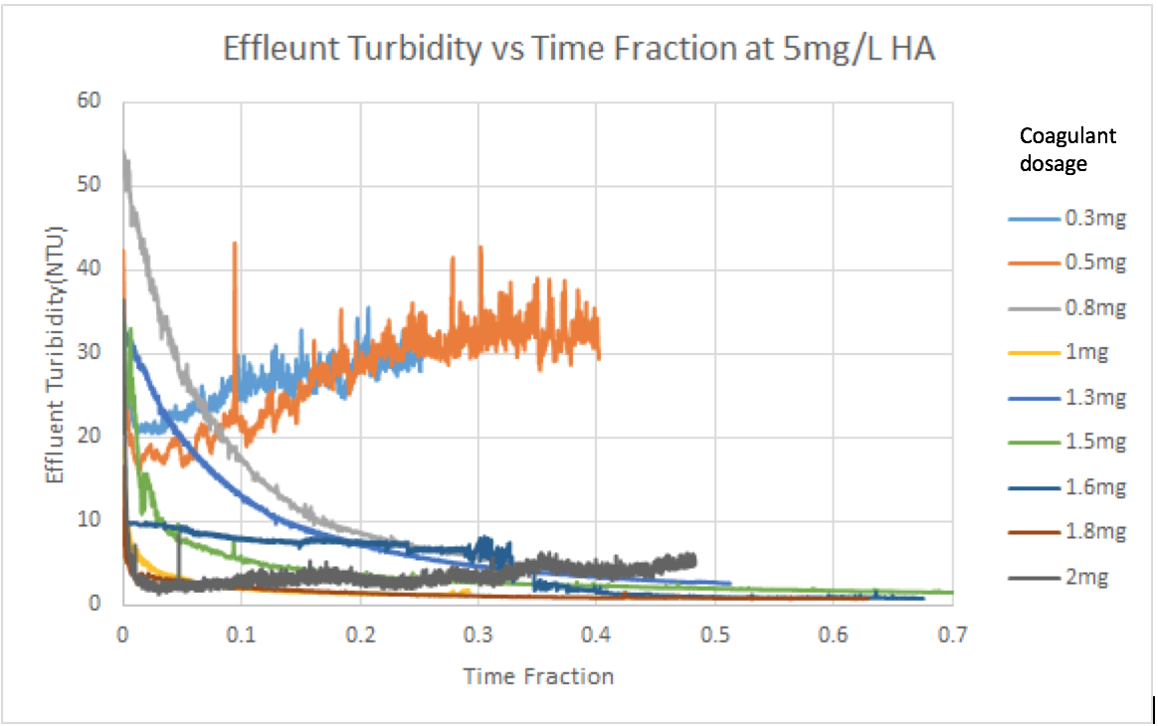
Previous Work
Fall ‘17 and Spring ‘18:
Concentration of Humic Acid (mg/L) | Optimal Coagulant Dosage (mg/L)
5 | 1.6 - 1.8
10 | 1.3
Fall ‘18:
Spectrophotometer
Linear relationships between absorbance and concentration/NTU
Mixture streams: experiments took too long to reach steady state
Humic Acid| Research | Symposium Presentation Fall 2019
Notes:
-Carolyn
Last year, the goal was to determine the optimal coagulant dosage for two humic acid concentrations, 5 mg/L and 10mg/L.
After the experiments done with different concentrations of coagulant, the team discovered the optimal dosage for 5 mg/L is 1.6 and for 10mg/L is 1.3 mg/L. The team tried to come up with a mathematical model to calculate the optimal coagulant dosage with known concentration of Humic Acid but the problem was that even with a large change in concentration, the resulting optimal dosage change is small.

Slide 4
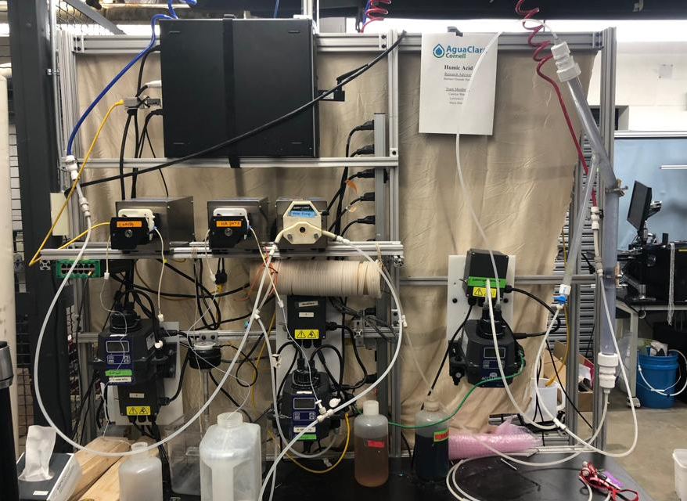
Experimental Design
Water in
Wastewater out
Recirculator
Coagulant pump
Water pump
Humic acid pump
Flocculator
Turbidimeter
Spectrophotometer
Humic Acid | Research | Symposiums Presentation Fall 2019
Notes:
-Maya
Three pumps: one for coagulant, HA, and water
Water is pumped from the inlet and combined with the HA, then goes into the turbidimeter
Then combines with coagulant stream and goes into the flocculator, then into the recirculator and sedimentation tank and then the spectrophotomer
Flocs go into the tube settler, then combine with the stream out of the spectrophotomer to go to the wastewater stream out

Slide 5
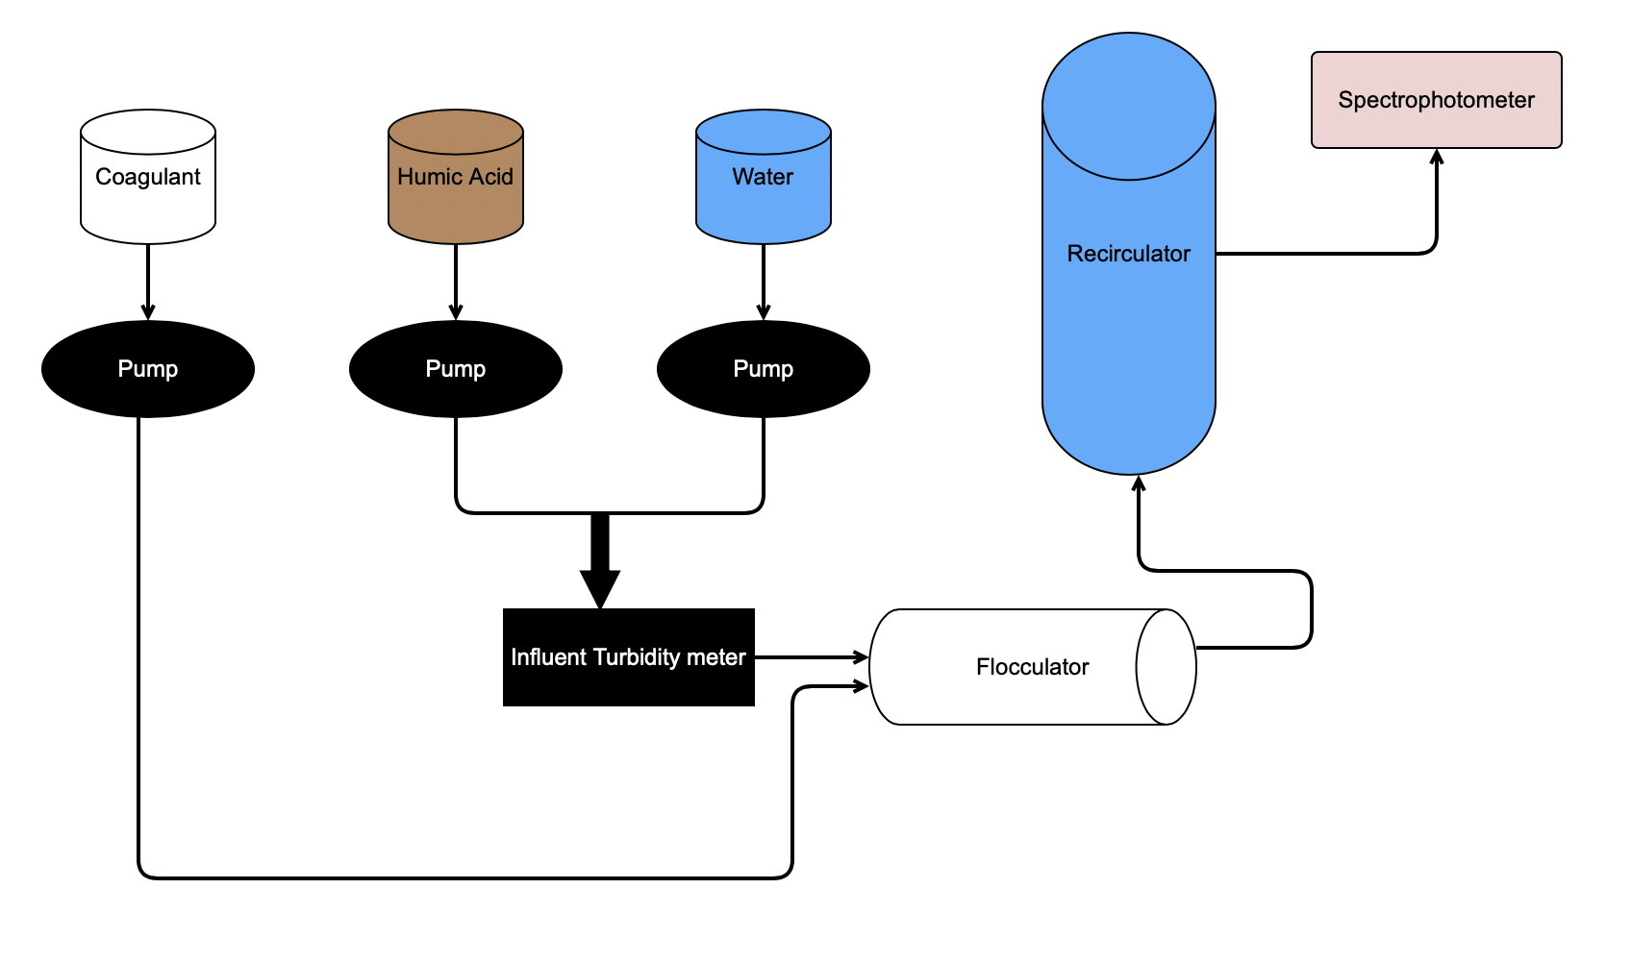
Schematic Drawing
Effluent Turbidity meter
Notes:
Maya

Slide 6
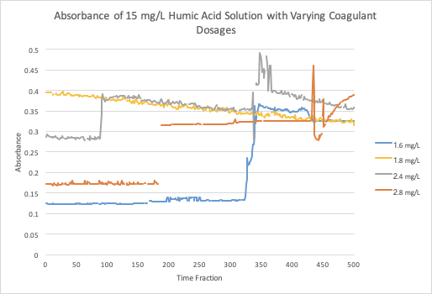
Experiment 1
Humic Acid:
15 mg/L
Coagulant:
1.6 mg/L
1.8 mg/L
2.4 mg/L
2.8 mg/L
Humic Acid| Research | Symposium Presentation Fall 2019
Notes:
EX 1 HA 15 Maya
first experiment we did we were not strict on the set-up so we were just waiting for the flocs to form. We observed that the absorbance goes down when we raise the concentration of coagulant. This can be seen when looking at the difference between 1.6 and 2.0 on the table, wherein the change in absorbance is a lot bigger than the change between 2.4 and 2.6. This indicates that there is a limit to how much the coagulant concentration can be increased before it stop having an effect on removing the HA from the water.
(for some concentrations, we were not able to collect sufficient data for analysis)

Slide 7
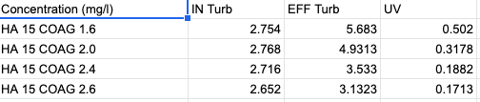
Experiment 1

Slide 8
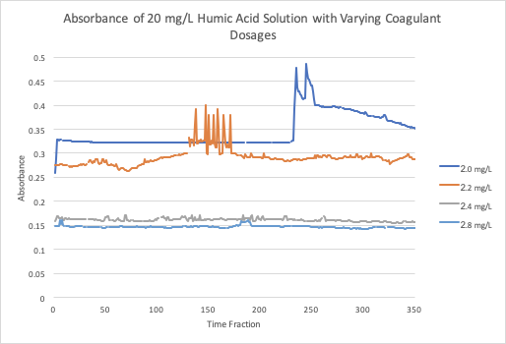
Experiment 2
Humic Acid:
20 mg/L
Coagulant:
2.0 mg/L
2.2 mg/L
2.4 mg/L
2.8 mg/L
Humic Acid| Research | Symposium Presentation Spring 2019
Notes:
EX 2 HA 20 Lawrence

Slide 9
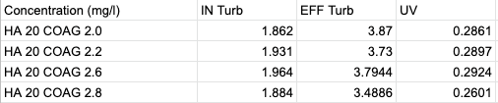
Experiment 2

Slide 10
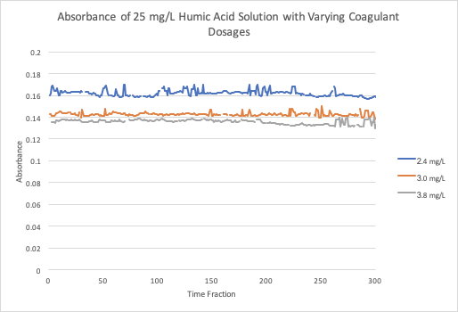
Experiment 3
Humic Acid:
25 mg/L
Coagulant:
2.4 mg/L
3.0 mg/L
3.8 mg/L
Humic Acid| Research | Symposium Presentation Spring 2019
Notes:
EX 3 HA 25 Lawrence

Slide 11
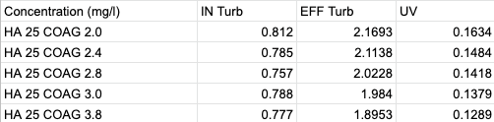
Experiment 3

Slide 12
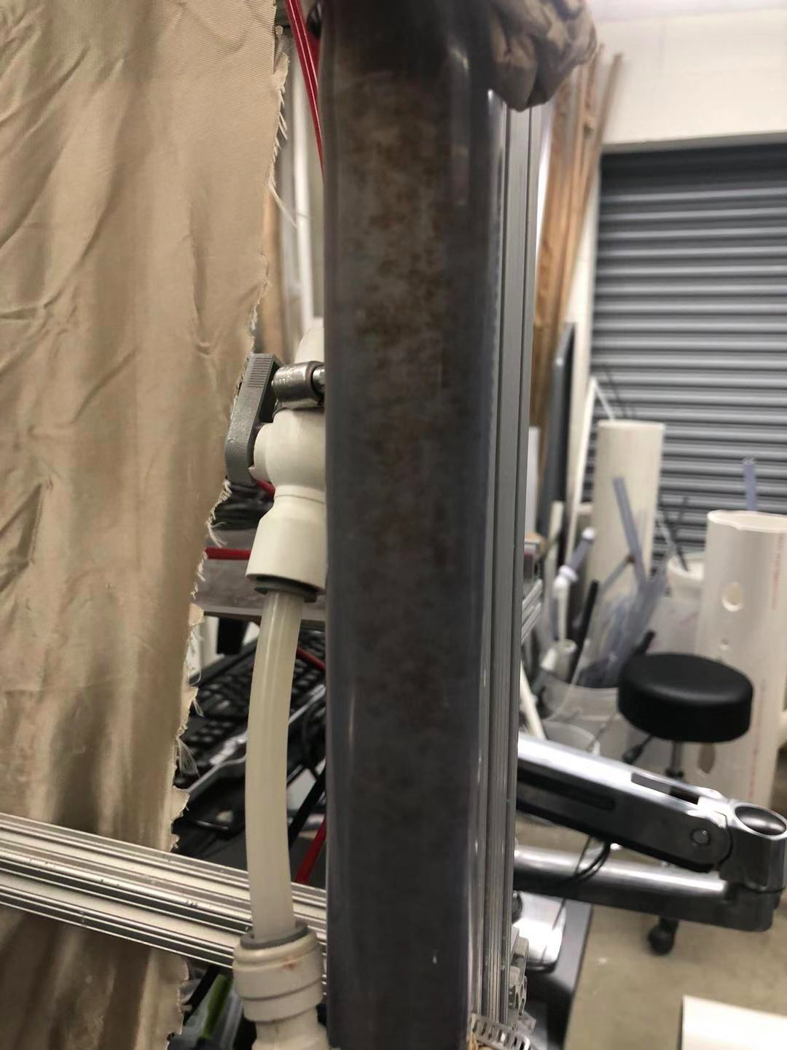
Analysis
Flocs form at slower speed
Small difference in absorbance with smaller concentrations of coagulant
Humic Acid| Research | Symposium Presentation Spring 2019
Notes:
Analysis Carolyn

Slide 13
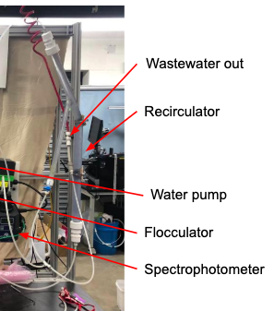
Complications
Each experiment is not done separately
Steady state not defined
Pump speed too low
Humic Acid| Research | Symposium Presentation Fall 2019
Notes:
Complications Carolyn

Slide 14
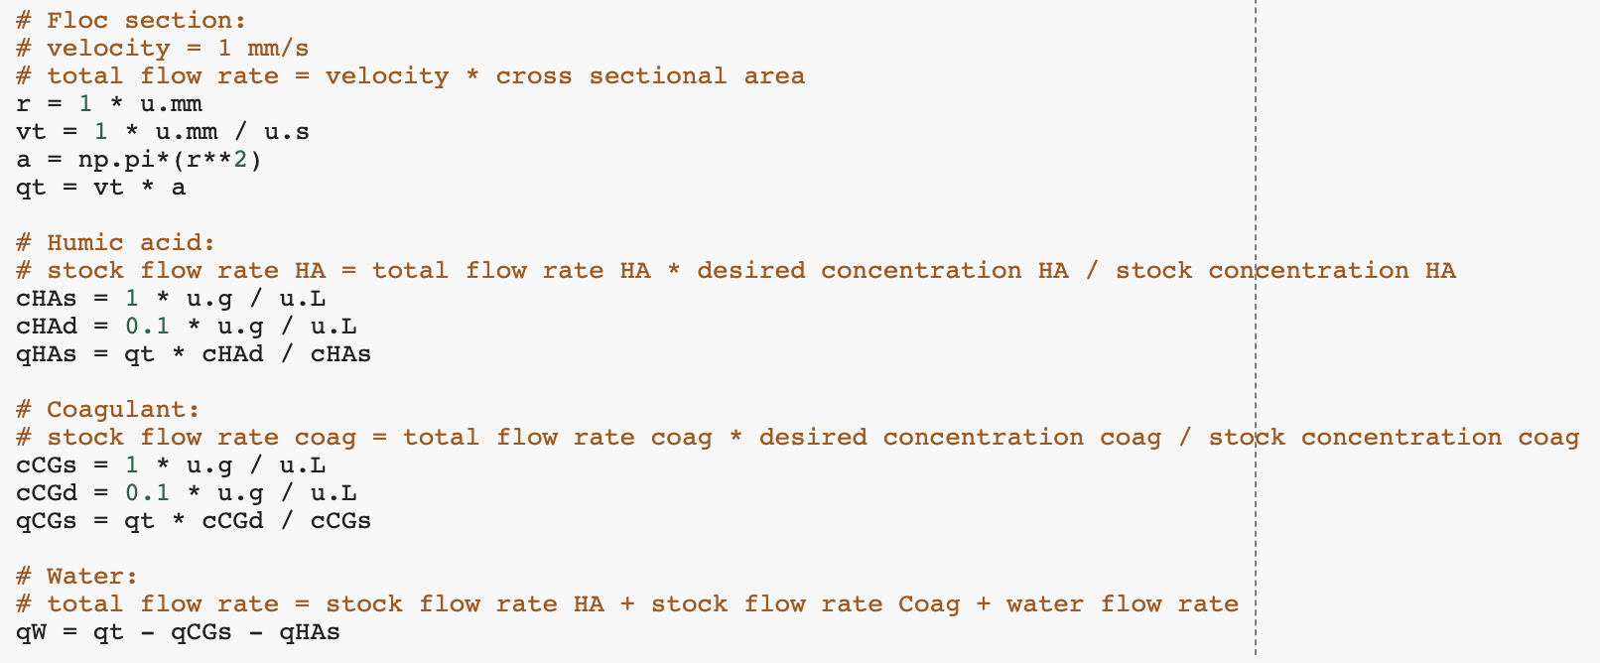
Python Code
Q_{i}C_{i}=Q_{o}C_{o}
where Q is the flow rate and C is the concentration of humic acid/coagulant
Humic Acid| Research | Symposium Presentation Spring 2019
Notes:
-Lawrence

Slide 15
Future Tasks
Test higher concentrations of Humic Acid and Coagulant
Take into account the time of experiments
Humic Acid| Research | Symposium Presentation Spring 2019
Notes:
-Carolyn

Slide 16
Questions
and
Recommendations
Carolyn Wang // jw2376@cornell.edu
Maya Shanti // ms2664@cornell.edu
Lawrence Li // ll678@cornell.edu
Humic Acid | Research | Symposium Presentation Spring 2019

Slide 17
Appendix
Slides
Humic Acid| Research | Symposium Presentation Spring 2019
Notes:
From this point on, add any slides with figures that will help support your thesis. You might pull these figures from your Final Report.

Slide 18
Bibliography
Logan, B. E., Hermanowicz, S. W., & Parker,A. S. (1987). A Fundamental Model for Trickling Filter Process Design. Journal (Water Pollution Control Federation), 59(12), 1029–1042.
Matilaninen, A, Vepsalainen, M & Sillanpaa, M. (2010). Natural Organic Matter Removal by Coagulation during Drinking Water Treatment. Adv Colloid Interface Sci.
Soh, YC, Roddick, F & Van Leeuwen, J. (2008). The Impact of Alum Coagulation on the Character, Biodegradability and Disinfection By-product Formation Potential of Reservoir Natural Organic Matter (NOM) Fractions. Water Sci Technol. 58(6), 1173-9.
Kopfler, F., H. Ringhand, W. Coleman, AND J. Meier. REACTIONS OF CHLORINE IN DRINKING WATER, WITH HUMIC ACIDS AND 'IN VIVO'. U.S. Environmental Protection Agency, Washington, D.C., EPA/600/D-84/196 (NTIS PB85160737).
Du, Y. (2017). Observations and a Geometric Explanation of the Effects of Humic Acid on Flocculation.
Humic Acid| Research | Symposium Presentation Spring 2019
Notes:
-Carolyn

